Slide 1
Transistor as a Switch
Switching and Amplification are the two areas of applications of Transistors and Transistor as a Switch is the basis for many digital circuits.

Slide 2
Introduction
As one of the significant semiconductor devices, transistor has found use in enormous electronic applications such as embedded systems, digital circuits and control systems. In both digital and analog domains transistors are extensively used for different application usage like amplification, logic operations, switching and so on.
The Bipolar Junction Transistor or simply BJT is a three layer, three terminal and two junction semiconductor device. Almost in many of the applications these transistors are used for two basic functions such as switching and amplification

Slide 3
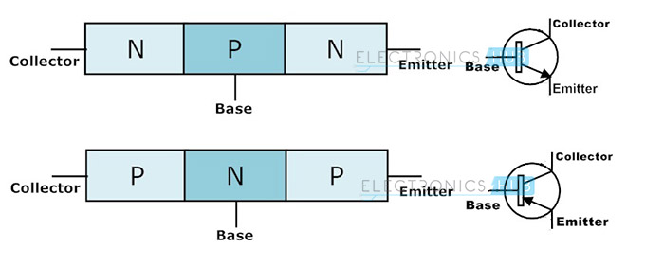
The name bipolar indicates that two types of charge carriers are involved in the working of a BJT. These two charge carriers are holes and electrons where holes are positive charge carriers and electrons are negative charge carriers.

Slide 4
Operating Modes of Transistors
Depends on the biasing conditions like forward or reverse, transistors have three major modes of operation namely cutoff, active and saturation regions.
Active Mode
In this mode transistor is generally used as a current amplifier. In active mode, two junctions are differently biased that means emitter-base junction is forward biased whereas collector-base junction is reverse biased. In this mode current flows between emitter and collector and amount of current flow is proportional to the base current.

Slide 5
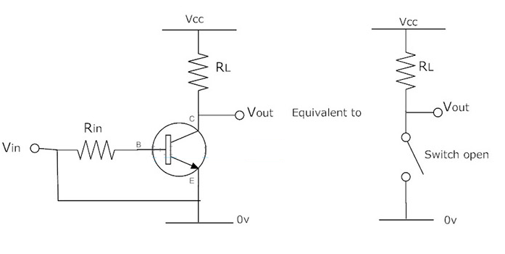
Cutoff Mode
In this mode, both collector base junction and emitter base junction are reverse biased. This in turn not allows the current to flow from collector to emitter when the base-emitter voltage is low. In this mode device is completely switched off as the result the current flowing through the device is zero.

Slide 6
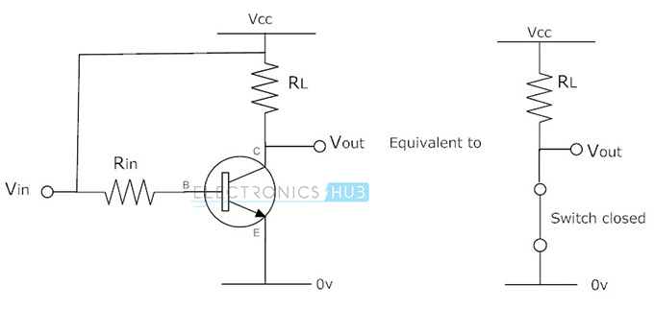
Saturation Mode
In this mode of operation, both the emitter base and collector base junctions are forward biased. Current flows freely from collector to emitter when the base-emitter voltage is high. In this mode device is fully switched ON.

Slide 7
Similarly, in the saturation region, a transistor is biased in such a way that maximum base current is applied that results maximum collector current and minimum collector-emitter voltage. This causes the depletion layer to become small and to allow maximum current flow through the transistor. Therefore, the transistor is fully in ON condition.
Hence, from the above discussion, we can say that transistors can be made to work as ON/OFF solid state switch by operating transistor in cutoff and saturation regions. This type of switching application is used for controlling motors, lamp loads, solenoids, etc.

Slide 8
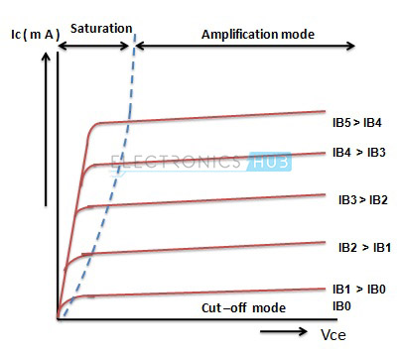
The below figure shows the output characteristics of a BJT Transistor. In the below figure cutoff region has the operating conditions as zero collector output current, zero base input current and maximum collector voltage. These parameters causes a large depletion layer which further doesn’t allow current to flow through the transistor. Therefore, the transistor is completely in OFF condition.

Slide 9
Transistor as a Switch
A transistor is used for switching operation for opening or closing of a circuit. This type solid state switching offers significant reliability and lower cost as compared with conventional relays.
Both NPN and PNP transistors can be used as switches. Some of the applications use a power transistor as switching device, at that time it may necessary to use another signal level transistor to drive the high power transistor.

Slide 10
NPN Transistor as a Switch
Based on the voltage applied at the base terminal of a transistor switching operation is performed. When a sufficient voltage (V_{in} > 0.7 V) is applied between the base and emitter, collector to emitter voltage is approximately equal to 0. Therefore, the transistor acts as a short circuit. The collector current V_{cc}/R_{c} flows through the transistor.
Similarly, when no voltage or zero voltage is applied at the input, transistor operates in cutoff region and acts as an open circuit. In this type of switching connection, load (here LED lamp) is connected to the switching output with a reference point. Thus, when the transistor is switched ON, current will flow from source to ground through the load.

Slide 11
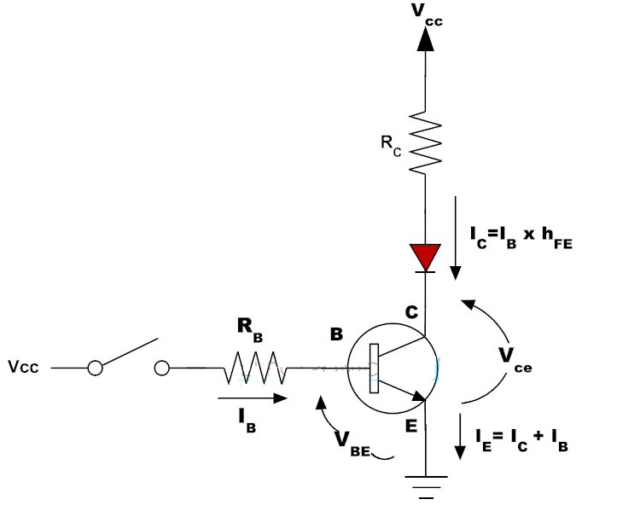

Slide 12
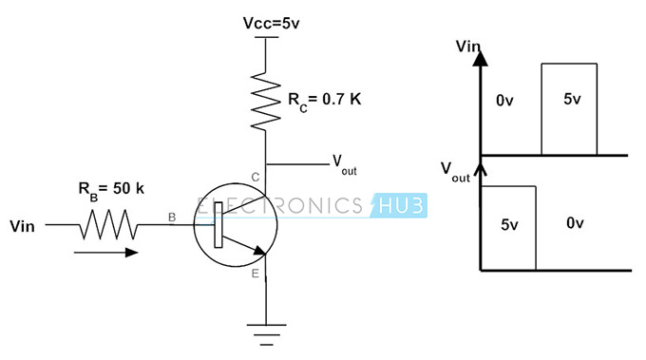
Example of NPN Transistor as a Switch
Consider the below example where base resistance R_{b} = 50 k ohm, collector resistance R_{c} = 0.7k ohm, V_{cc} is 5V and the beta(I_{c}/I_{b}) value is 125. At the base input a signal varying between 0 and 5V is given so we are going to see the output at the collector by varying the V_{i} at two states that is 0 and 5V as shown in figure.

Slide 13
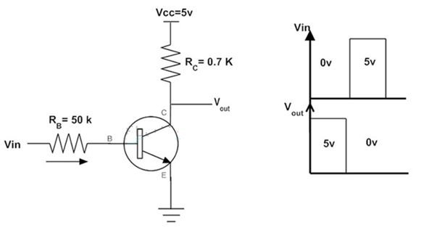
I_{c} = V_{cc}/R_{c} when V_{CE} = 0
I_{c} = 5V/0.7k ohm
I_{c} = 7.1 mA
Base Current I_{b} = I_{c} / β
I_{b} = 7.1 mA/125
I_{b} = 56.8 µA
From the above calculations, the maximum or peak value of the collector current in the circuit is 7.1mA when Vce is equal to zero. And the correspond base current to which collector current flows is 56.8µA. So, it is clear that when the base current is increased beyond the 56.8 micro ampere then the transistor comes into the saturation mode.

Slide 14
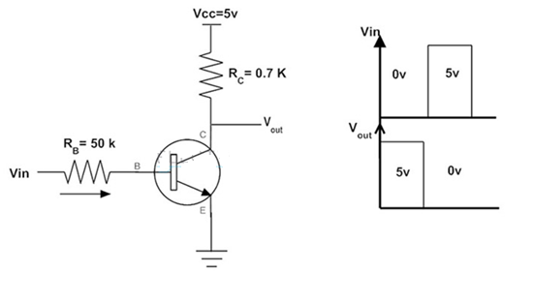
Consider the case when zero volt is applied at the input. This causes the base current zero and as the emitter is grounded, emitter base junction is not forward biased. Therefore, the transistor is in OFF condition and the collector output voltage is equal to 5V.
When V_{i} = 0V, I_{b} = 0 and I_{c} =0,
V_{c} = V_{cc} – (I_{c}R_{c})
= 5V – 0
= 5V
Consider that input voltage applied is 5 volts, then the base current can be determined by applying Kirchhoff’s voltage law.
When V_{in} = 5V
I_{b} = (V_{in} – V_{be}) / R_{b}
For silicon transistor V_{be} = 0.7 V
Thus, I_{b} = (5V – 0.7V)/ 50K ohm
= 86 µA which is greater than 56.8 µA

Slide 15
Therefore the base current is greater than 56.8 micro ampere current, the transistor will be driven to saturation that is fully ON when 5V is applied at the input. Thus the output at the collector becomes approximately zero.
PNP Transistor as a Switch
PNP transistor works same as NPN for a switching operation, but the current flows from the base. This type of switching is used for negative ground configurations. For the PNP transistor, the base terminal is always negatively biased with respect to the emitter. In this switching, base current flows when the base voltage is more negative. Simply a low voltage or more negative voltage makes transistor to short circuit otherwise it will be open circuited or high impedance state.

Slide 16
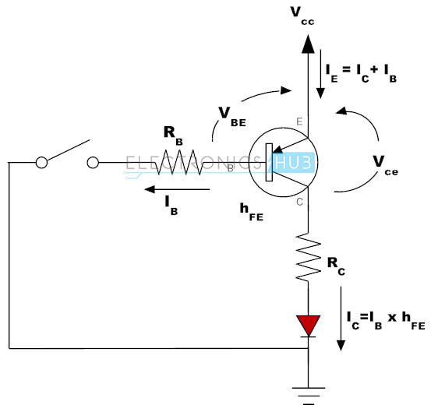
In this connection, load is connected to the transistor switching output with a reference point. When the transistor is turned ON, current flows from the source through transistor to the load and finally to the ground.

Slide 17
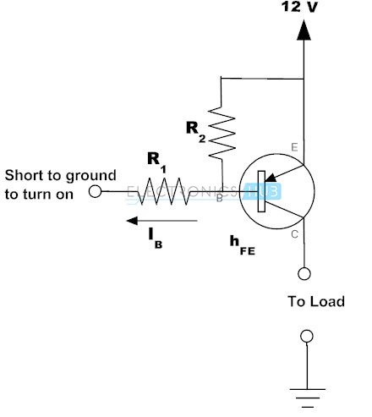
Example of PNP Transistor as a Switch
Similar to the NPN transistor switch circuit, PNP circuit input is also base, but the emitter is connected to constant voltage and the collector is connected to ground through the load as shown in figure.

Slide 18
In this configuration base is always biased negatively with respect to the emitter by connecting the base at negative side and the emitter at the positive side of the input supply. So the voltage V_{BE} is negative and the emitter supply voltage with respect to the Collector is positive ( V_{CE} positive).
Therefore, for the conduction of transistor emitter must be more positive with respect to both collector and base. In other words base must be more negative with respect to the emitter.

Slide 19
For calculating the base and collector currents following expressions are used.
I_{c} = I_{e} – I_{b}
I_{c} = β. I_{b}
Since β= Ic/ I_{b}
I_{b} = I_{c} / β
Consider the above example, that the load requires 100 milli ampere current and the transistor has the beta value of 100. Then the current required for the saturation of the transistor is

Slide 20
Minimum base current = collector current / β
= 100 mA / 100
= 1mA
Therefore, when the base current is 1 mA, the transistor will be fully ON. But practically 30 percent of more current is required for guaranteed saturation of transistor. So, in this example the base current required is 1.3mA.

